Slide 1
Real time video Stabilization Pantheon HackZon 2022
New Horizon college of engineering
Team Members:
Mohammed Adnan Khan
SAI kiran
Kammar Trivikram

Slide 2
Problem statement
To create an efficient deterministic algorithm that can stabilize a bounding box in a video, wrap the image and show the clean output in an another window. (creating a video stabilizer)

Slide 3
C++ and openCV
C++ by far the fastest and powerful programming language. We could get the most efficiency by programming in c++. C++ directly compiles the code into machine code.
OpenCV is open source library, for image/video manipulation designed for computer vision.

Slide 4
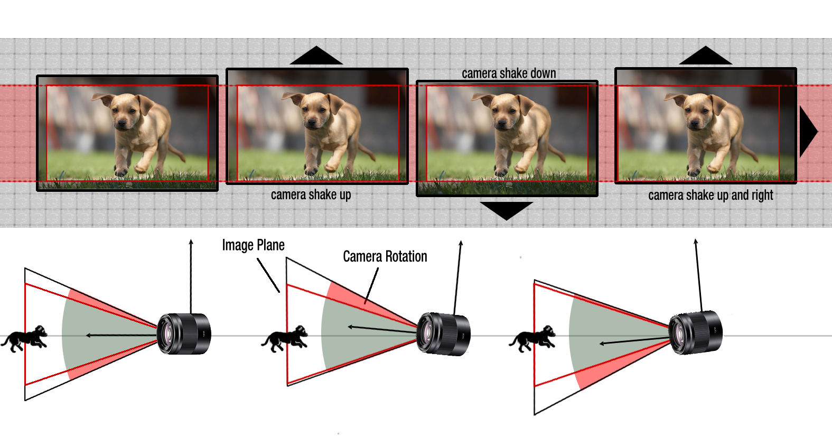
EIS – Electronic Image stabilization

Slide 5
How the program works ? (implementation)
Originally the project was made to detect and work as a document scanner. This program checks for any available camera devices that are attached to the computer (web camera in my case), if available, it then uses it. Then we apply the Pre-processing of the image, then we get the Contours, then we Warp the image and display the image in another window. This process happens continuously such that the effect at large scale is treated as a video rather than image
Preprocessing Step
Convert the raw image to gray scale (cvtColor())
Convert the gray scale image to blurred image (GaussionBlur())
Convert the blurred image to a canny image (canny is used to detect the edges) (Canny())
Covert the canny image to a dilated canny image (dilate())

Slide 6
Getting the Contours (Shape detection)
Finding the Contours (shapes) in the dilated canny image (findCotours())
Finding the area of the shapes found in the image (contourArea())
Filtering the shapes for a threshold area
Optional: Draw Contours around the shape (drawContours())
Finding the number of points in a given shape
Optional: Draw the Contours around the shape by using the point reference
Filtering the shapes by number of points and max area of a shape (rectangles are filtered in)
Return the points of the biggest rectange
Warpping the image (Feature not found in typical applications)
Wrapping the by considering the givern points (warpPerspective())
The final wrapped image then displayed onto a seperate window

Slide 7
Future scope
To embed this program into other projects so that the efficiency of the applications increases.
This program can also be used in machine learning to increase efficiency, for example number plate detection, we can directly use this program to detect the number plates

Slide 8
Example

Slide 9
Thank you Team Pantheon

